Slide 1
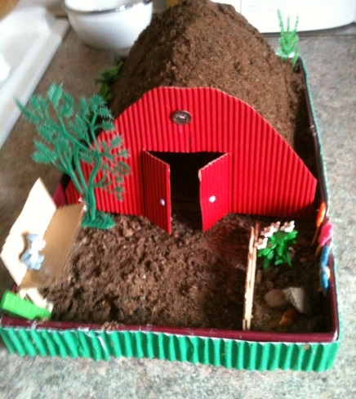

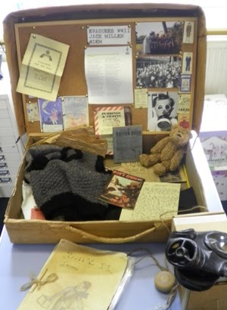
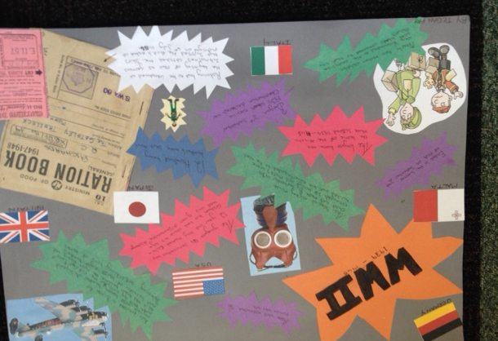
Optional Task 1
Make an air raid shelter/Anderson shelter. Think about which materials would be best to use. Alternatively, design one and annotate it, explaining what you have chosen to use and put where and why.
Optional Task 2
Imagine you are an evacuee. Write a postcard home to your family explaining what has happened to you since leaving and how your feeling. Think about how a child from these times would have written. Perhaps look at some diaries of WWII children, for example, Anne Frank.

